Slide 1
In this information section we would like to explain
How the Nursery works within the West Bedlington Early Years Partnership
What our initial aims are as your child starts with us in September
Welcome to West
End Primary School Nursery

Slide 2
When your child starts in September he/she will be in the Nursery, which we call Apple Class. This is part of West End Primary School.

Slide 3
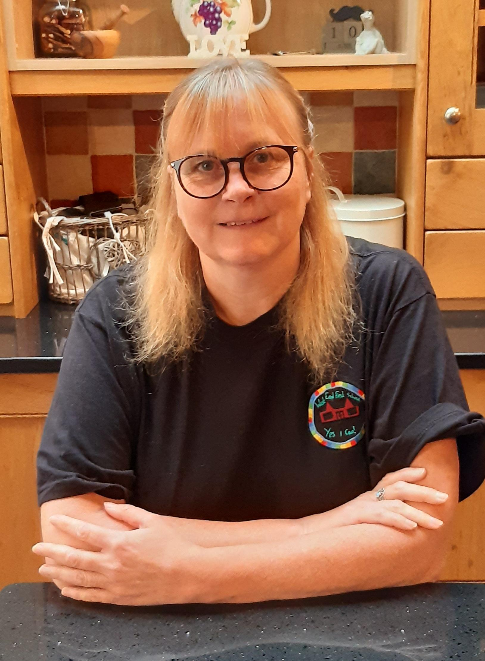
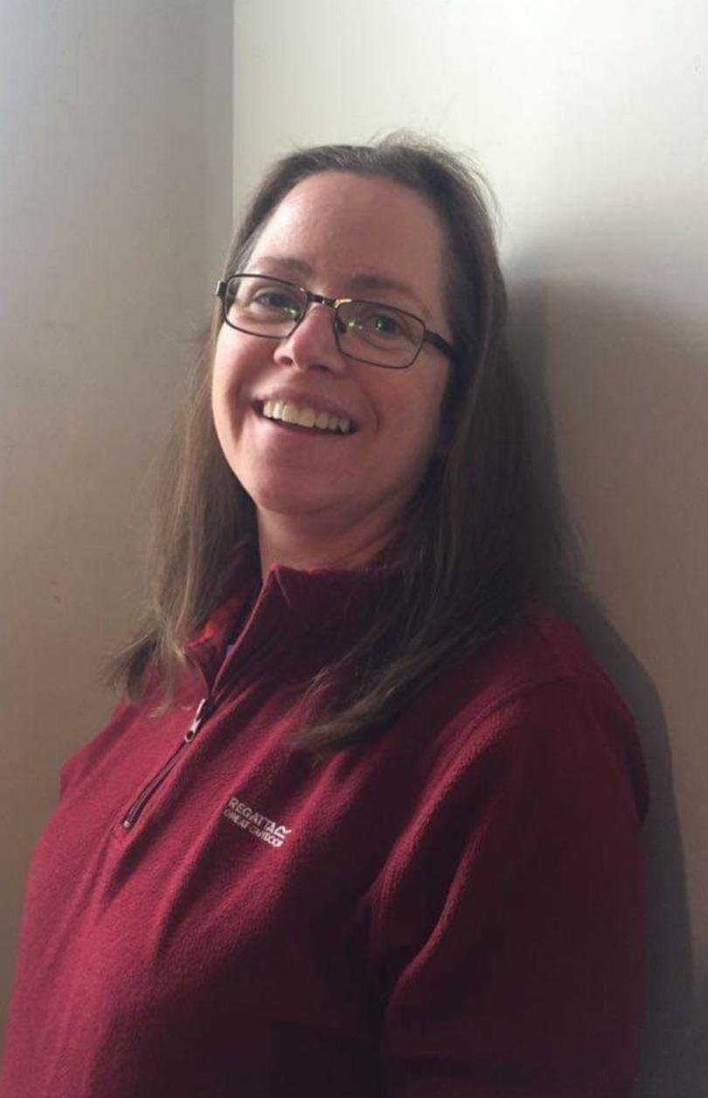
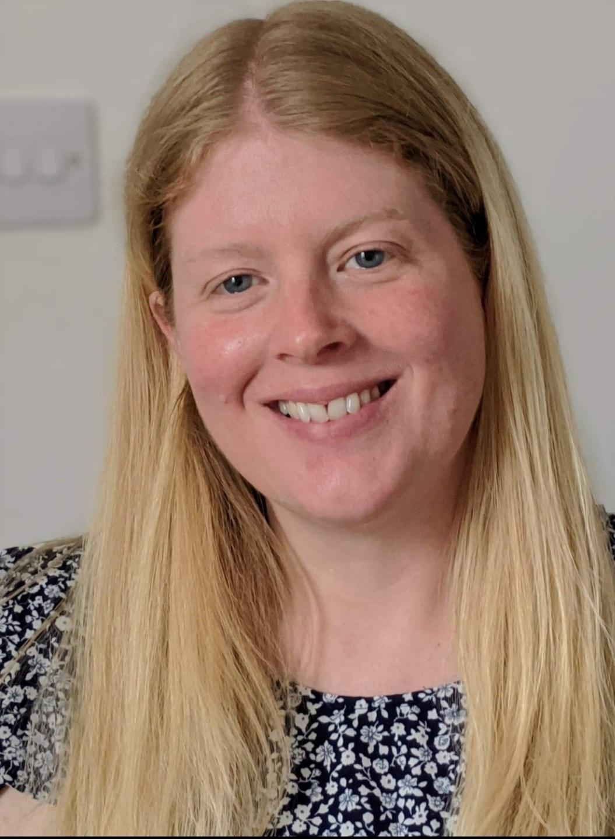
The Staff are
Miss Karen
Porter
.
Miss Rachel
Nancekivell
Mrs Victoria Graham

Slide 4
We work in close partnership with
West End Pre-School to deliver
Seamless early childhood learning from the age of 2 years through, into Reception.
West End Pre-School specialise in 2 year old provision, with the children transferring to West End Primary Nursery in the September after their third birthday.
Together we are known as the West Bedlington Early Years Partnership.

Slide 5
How we work
Despite being two separate organisations we work in the same building, planning together and creating a shared indoor and outdoor learning environment, which all of the children can access.
We also have shared Safeguarding and Data Sharing Protocols. As well as Behaviour Management and Intimate Care Policies.
We share responsibility for assessments and for the safety and wellbeing of the children.

Slide 6
What we provide
West End Primary
Nursery
15 or 30 hours (where eligible) provision for those children who are 3 years old before the 1st of September in the school academic year.
West End Pre-School
15 hours provision for 2 year olds from their 2nd birthday
15 or 30 hours (where eligible) provision for those children who are 3 until the point they transfer to West End Nursery in the September after their 3rd birthday.

Slide 7
Eligibility for funded places
If you meet certain criteria you may be eligible for funded places for your child to access 30 hours provision in Nursery.
You can check your eligibility by visiting the website below.
You would need to do this now ready for September then reconfirm this each term.
You would also need to let the school know by contacting Mrs Markham -Lee in the office on 01670 822328.
www.childcarechoices.gov.uk

Slide 8
West End Pre-School Staff
April
Julia
Eithne
Louise
Alison

Slide 9
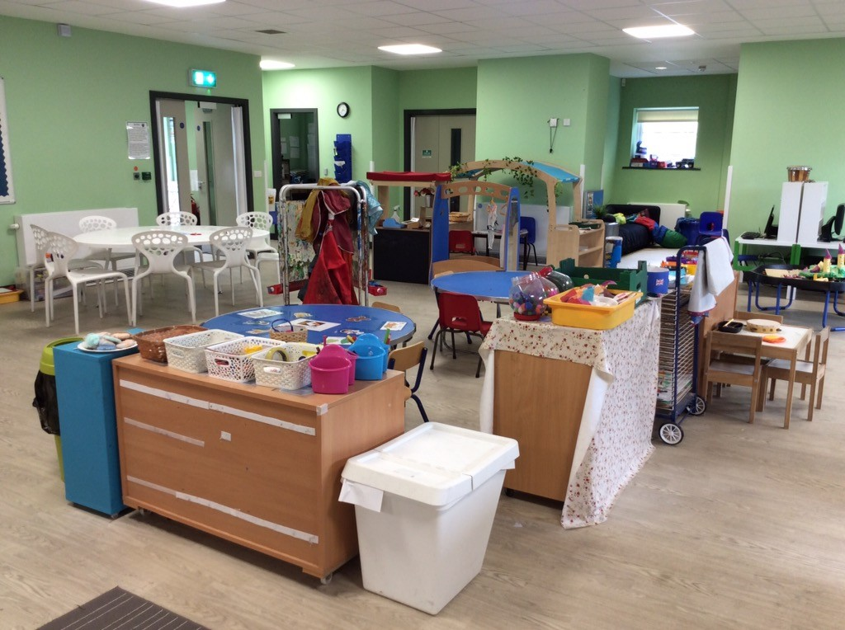
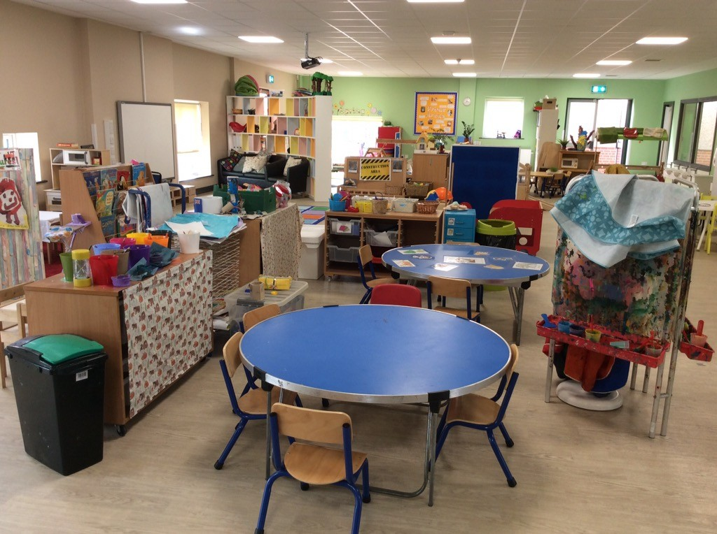
The Partnership Building
The building is a large purpose built building, designed to accommodate younger children.
It has access to the outdoors, changing and dining facilities. This means that those children accessing 30 hours provision are able to stay in the one setting throughout the day.

Slide 10
Our Aims
To have each child feel safe and happy in Nursery.
To settle into their new routine as quickly as possible.
To help the children staying in Nursery and those children coming from Preschool, neighbouring playgroups and nurseries to build relationships with us and each other.
To develop a learning partnership with yourselves. As you are the prime educators of your child and you know them best.

Slide 11
Feeling Safe and Happy
We are busy talking to your child’s current setting to find out as much as we can about them.
We will also be sending out a PDF e-book about Starting Nursery for you to share with your child.
We will be posting videos on Tapestry and having two way dialogue with you and your child.

Slide 12
New Routines
Children respond to the challenge of school life in different ways so don’t worry if it takes your child more time to settle than others.
We will be sharing some of the routines in your child’s book so you can start to talk about them.
We will try to establish a familiar routine as quickly as we can.
We model and teach these routines so they become familiar with them.
The staff realise how valuable and special your children are and we will try our best to settle the children in.
Please come and talk to a member of staff if you have any concerns at all.

Slide 13
Building Relationships
We will be supporting the children to work with other children and staff.
There will be opportunities for your child to work:
One to one with staff on activities staff choose
On activities which they have chosen themselves with staff
With other children in small groups
With larger groups (when the children are ready)
With their friends

Slide 14
Building A Partnership With You
Before your child starts
We will be sending out lots of transition information.
Usually we use Tapestry as a Learning Platform however in the current situation if you would like to ask any questions you can pop them on there and we will get back to you.
When your child starts
There will be an adult on the door to greet you.
There will be an adult to see children out at home time.
You will receive a Transition Report at the end of the year.
There will be activities you can take part in when we are able.

Slide 15
Building A Learning Partnership With You
You know your child best
We will be posting photographs, videos and assessments on your child’s online Learning Journal and Learning Platform....TAPESTRY.
It would be wonderful if you could also post some of the things your child does at home as this gives us a picture of your whole child in different situations.
We will provide assessments on Tapestry so you can see where your child is in terms of their development.

Slide 16
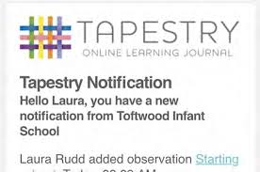
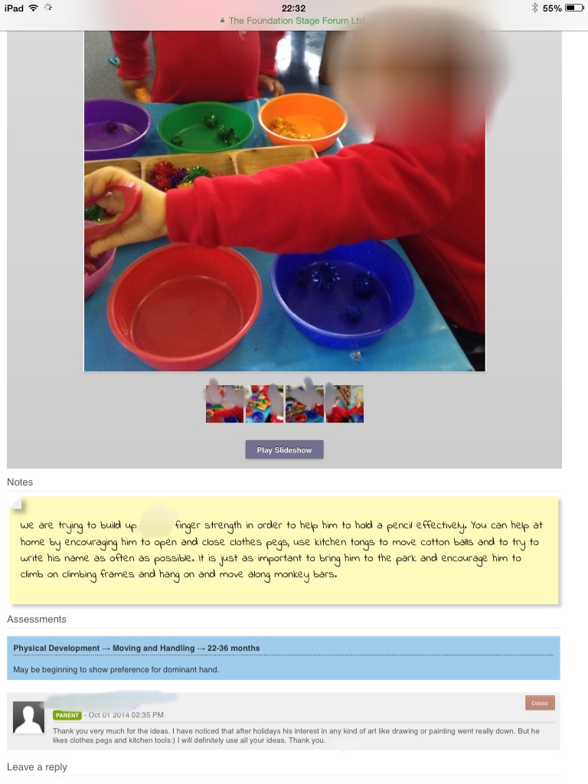
Picture of the activity
Explanation of the task showing your child’s experiences, learning and suggested next steps
Opportunity to comment on the learning, perhaps saying if you have talked about this at home, seen evidence etc
Links to EYFS curriculum and levels of development
Clicking ‘like’ helps us know that you have read the observation

Slide 17
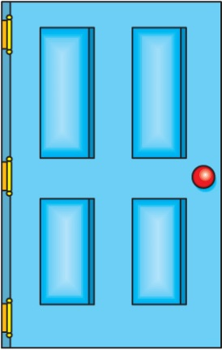
Our door is always open!
We also aim to involve you in your child's learning, when it is safe to do so, through:-
Stay and do sessions
Tapestry (online Learning Journal)
Information events e.g. early literacy/numeracy
Please DO talk to us! We’re happy to answer any queries
Our next information section to follow is about helping prepare your child for Nursery.

