Slide 1
Our School
A huge thank you to all of our lovely parents and family members who donated and spent money at the Enterprise Fair. It was wonderful to see so many of you there supporting your children and their entrepreneurial skills.
We are looking forward to seeing what they decide to spend their profits on!
We look forward to seeing many of you at the upcoming sports day events.
Mrs J Dey
Headteacher
Northern Lights host a coffee morning at 9:30 on a Monday at Weatherspoons for parents of children with SEN.
All welcome.
June 2025

Slide 2
Shout outs!
Celebrating excellence across school
Top table (children showing lovely manners at lunchtime): tables 4, 6 & 1
Attendance (the class with the best attendance that week): Hazel, Cedar, & Rowan
Staff (the staff member/s who deserves recognition): Mrs Angela Markham-Lee for working tirelessly above and beyond to ensure our wrap around provision is a success.
Parents: A huge thank you to Mr Paul Scott for arranging for the bake sale money to be matched by Bellway.

Slide 3
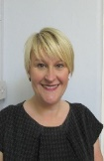
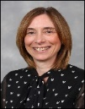
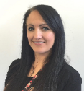
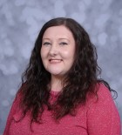
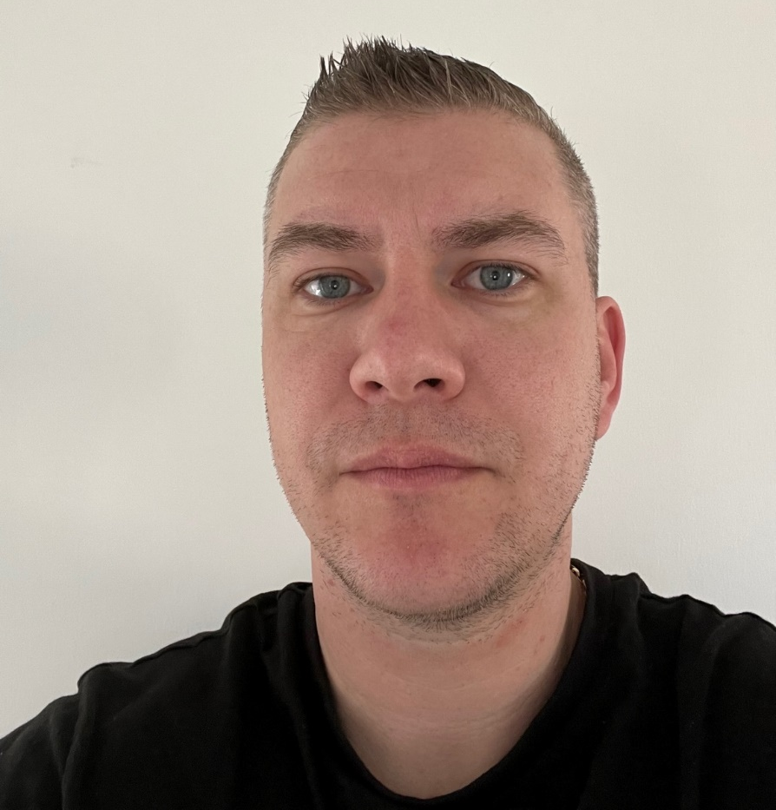
Safeguarding
Safeguarding message
The impact of shouting and arguing
A study completed by the Journal of Family Psychology followed over 200 families for ten years and found:
Kids who saw their parents argue a lot were more likely to experience anxiety, depression, and behavioural issues later in life. And it didn’t matter if the arguments got resolved or not. What mattered was how often and how intensely the parents argued.
Arguing at home can even make it hard for kids to do well in school. Kids who hear their parents argue a lot have trouble paying attention in school. The stress caused by conflict between parents can make it harder for children to focus, absorb information, and give their full effort.
Shouting at a child can have several negative effects on their development and well-being, including increased anxiety, depression, behavioural problems, and difficulties in forming healthy relationships. It can also disrupt brain development, leading to emotional dysregulation and impaired decision-making. If you have concerns, contact one of the team above or Northumberland Social Services: 01670 536400.
Mrs Waters
DDSL
Mrs McLeod
DDSL
Mrs
Dey
DSL
Miss Maddison
DDSL
Mr Chapman
Safeguarding Governor

Slide 4
Safeguarding
Key Findings from the OFCOM 2025 Report:
Increased Online Presence: The report highlights that 85% of children aged 5-15 now have access to a smartphone, and 75% of children aged 8-11 have their own social media profiles 1.
Exposure to Inappropriate Content: Alarmingly, 40% of children aged 12-15 reported encountering harmful or inappropriate content online 1.
Parental Concerns: 70% of parents expressed concerns about their children's online safety, particularly regarding exposure to inappropriate content and interactions with strangers 1.
Recommendations for Parents:
Open Communication: Regularly discuss online activities with your children. Encourage them to share their experiences and any concerns they might have.
Use Parental Controls: Utilize the parental control features available on devices and platforms to monitor and limit your child's online activities.
Educate About Privacy: Teach your children the importance of not sharing personal information online and the potential risks associated with it.
Stay Informed: Keep yourself updated on the latest trends and potential threats in the digital world. The OFCOM website is a valuable resource for this while the NSPCC website shares many hints and tips for parents/carers.
*Please also see attached information for parents and carers.
Mrs Waters
DDSL
Mrs McLeod
DDSL
Mrs
Dey
DSL
Miss Maddison
DDSL
Mr Chapman
Safeguarding Governor

Slide 5
Attendance Target 96% +
Being in school is important to your child's academic achievement, wellbeing, and wider development. There is evidence to suggest that regular school attendance is a key mechanism to support children and young people's educational, economic and social outcomes.
Beech | Sycamore | Hazel | Oak
93% | 93% | 96% | 93%
Chestnut | Elm | Rowan | Cedar
95% | 95% | 97% | 93%
Whole school
94%
Well done Rowan class – our best attenders!

Slide 6
Important Upcoming Events to Note:
Sports Days:
EYFS – Monday 7 July @ 9:30 St Bede’s field
Years 1, 2 & 3 – Tuesday 8 July @ 9:30 St Benet Biscop’s field
Years 4, 5 & 6 – Thursday 10 July @ 1:30 St Benet Biscop’s field
Y6 Leaving:
Performance – Wednesday 9 July @ 5pm
Assembly – Wednesday 16 July @ 2pm
Class assemblies:
Nursery – July 2nd @ 9am
Y1 – July 4th @ 9am
Y6 – July 16th @ 2pm
Transition day:
Tuesday 1st July
Reception Graduation:
Tuesday 15 July @ 9:15

Slide 7
Bedlington Family Hub
Bedlington Family Hub have lots of great things on offer for parents and children.
Pop in Tuesday is a great opportunity to go for a chat and learn more about what they offer.
Representatives from the family hub will be attending our upcoming parent evenings. Please talk to them and see what they have to offer.

Slide 8
Diary Dates
Tuesday 1 July – Transition day
Wednesday 2 July – Nursery class assembly @ 9am
Friday 4 July – Y1 class assembly @ 9am
Monday 7 July – Nursery & Reception Sports day @ 9:30
Tuesday 8 July – Years 1, 2 & 3 Sports day @ 9:30
Tuesday 8 July – Reception Plessey Woods trip
Wednesday 9 July – Y6 leavers’ play to parents @5pm
Thursday 10 July – music performance to parents of children who have music lessons
Thursday 10 July – Years 4, 5 & 6 Sports day @ 1:30
Friday 11 July – Y1 and Y2 beach trip
Tuesday 15 July – Reception Graduation event
Tuesday 15 July – PTFA summer disco – more info soon
Wednesday 16 July – Y6 leavers assembly to parents @2pm
Thursday 17 July – Best Of West End Ceremoney – children come to school in their best clothes for the awards. No room for parents unfortunately.
Friday 18 July – Children can bring in a toy.
Friday 18 July @ 3:30 Y6 children leave through the hall doors through a corridor of staff and parents on the yard clapping them out.
Clothes Bank
We are working in partnership with the Clothes Bank at Hope Church Bedlington. They accept children’s uniform, fancy dress, Christmas jumpers and clothing in good condition.
They are in need of white Polo shirts and shirts
In the months of February 2024 and January 2025 they welcomed 735 visitors and have given out almost 2100 items of uniform and children’s clothing, which means, they have prevented them being thrown away and going to landfill.
Please use them instead of buying new.
Opening hours
Friday 18 July – school closes for Summer end of term

Slide 9
Apple class Nursery
Nursery children have enjoyed all things minibeast!

Slide 10
Beech class Reception
Reception have enjoyed 70s day, minibeast making, Lillidorei trip with their buddies in Y5, and stay and play with parents.

Slide 11
Sycamore class Y1
Year 1 children have enjoyed Outdoor Adventurous Activites, 70s day and Enterprise.

Slide 12
Hazel class Y2
Year 2 children have enjoyed Whitehouse Farm, making tea, 70s day and Enterprise!

Slide 13
Oak class Y3
Year 3 have really enjoyed 70s day and sampling South American food!

Slide 14
Chestnut & Elm class Y4
Chestnut and Elm class have enjoyed Enterprise, St Mary’s Lighthouse and 70s day.

Slide 15
Rowan class Y5
Rowan class have enjoyed 70s day, class assembly, making masks, girls football event with Y6 and Lillidorei with Reception.

Slide 16
Cedar class Y6
Year 6 have enjoyed 70s day, bike festival, making shadows and girls football with Y5!

Slide 17
Wrap Around Care The Den!
Our wrap around provision continues to grow. There are so many lovely things for your child to do with us. We have reintroduced the Wednesday cooking club. This is very popular so make sure you book in quickly!
Open from 7:30am to 6pm.
Please book through the school office

Slide 18
Voice of the School Council
The school council continue to work on organising playground games and equipment for playtimes.
They are thinking about how they can raise money to make playtime and lunchtime even better with even more equipment.
Child voice is so important to us.

Slide 19
All things PTFA
A very big thank you to the parents who volunteer to support the PTFA as well as the PTFA members. We really appreciate all your hard work.
The PTFA need volunteers in order to continue their great work. If you can spare any time at all please get in touch. Each year the money raised goes back into school to provide extra special things for your children.
Thanks to your generosity at events the PTFA are on the way to raising the £3000 needed for the whole school to attend a pantomime and for early years to have a pantomime visit them in 2025.
Huge thank you to Bellway for matching money raised from the bake sale!
Summer Disco: Tuesday 15 July at Netherton Club

